Slide 1
Handwritten Text Recognition System using TensorFlow
RNS INSTITUTE OF TECHNOLOGY
BENGALURU - 98
DEPARTMENT OF INFORMATION SCIENCE & ENGINEERING
Presentation on Internship
RUSHWANTH K
1RN19IS123

Slide 2
AGENDA
Abstract
About the Company
Introduction
Literature Survey
Requirements
System Design
Detailed Design
Implementation
Results
Conclusion and Future Enhancements
References
Q & A

Slide 3
ABSTRACT
Character recognition is one in all the emerging fields within the computer vision.
The most abilities of humans are they will recognize any object or thing. The hand transcription can be easily identify by humans. Different languages have different patterns to spot. Humans can identify the text accurately.
The hand transcription cannot be identified by the machine. It's difficult to spot the text by the system.
During this text recognition, we process the input image, extraction of features, and classification schema takes place, training of system to acknowledge the text.
During this approach, the system is trained to seek out the similarities, and also the differences among various handwritten samples.
This application takes the image of a hand transcription and converts it into a digital text.

Slide 4
ABOUT THE COMPANY
NASTECH – New Age Solutions & Technologies
NASTECH is formed with the purpose of bridging the gap between Academia and Industry.
Nastech is one of the leading Global Certification and Training service providers for technical and management programs for educational institutions.
They collaborate with educational institutes to understand their requirements and form a strategy in consultation with all stakeholders to fulfill those by skilling , reskilling and upskilling the students and faculties on new age skills and technologies.
Industry and project oriented student training programs.
Certification programs mapped to Global Certification Exams from Microsoft/EC- Council/Google/AWS/ Adobe).

Slide 5

INTRODUCTION
A minimalistic neural network implementation which can be trained on the CPU.
Offline Handwritten Text Recognition (HTR) systems transcribe text contained in scanned images into digital text
We will build a Neural Network (NN) which is trained on word-images from the IAM dataset.
As the input layer (and therefore also all the other layers) can be kept small for word-images, NN-training is feasible on the CPU (of course, a GPU would be better).
This implementation is the bare minimum that is needed for HTR using TF.

Slide 6
LITERATURE SURVEY
K. Gaurav, Bhatia, various pre-processing techniques involve within the character recognition with different reasonable images ranges from easy handwritten form-based documents and documents containing colored and complicated background and varying intensities.
The offline character recognition is proposed by sing diagonal feature extraction. it's supported by the ANN model. There are two approaches to make neural network system such as 54 feature and 69 features.
A. Brakensiek, J. Rottland, A. Kosmala, J. Rigoll, during this paper a system for off-line cursive handwriting recognition was described which is based on Hidden Markov Models (HMM) using discrete and hybrid modeling techniques.
R. Bajaj, L. Dey, S. Chaudhari, has employed three different styles of features, such as, the density features, moment features, and, descriptive component features for classification of Devanagari Numerals.
They obtained 89.6% accuracy for handwritten Devanagari numerals.

Slide 7
LITERATURE SURVEY
M. Hanumadhulu and O.V. Ramanammurty have implemented this using a fuzzy set using the box approach and also the recognition is 90%.
This model operates on varied information sources.
In past researches, it's clear that this model is successful with diverse information sources but it lacks a small amount of accuracy within the case of long sentences.
Many proposed models don't seem to be so successful incorrectly classifying the long text data.
On the other side models are incorporating CNN networks and showing good results which are because of its capability of dealing the longer text data.

Slide 8
REQUIREMENTS
HARDWARE REQUIREMENTS
Processor : Any Processor above 500 MHz
RAM : 512Mb
Hard Disk : 4 GB
Input device : Standard Keyboard and Mouse
Output device : VGA and High Resolution Monitor
SOFTWARE REQUIREMENTS
Operating system : Windows 10
IDE : Google collab(Any browser)
Tools/Technologies : Python, tensorflow, cv2, streamlit

Slide 9
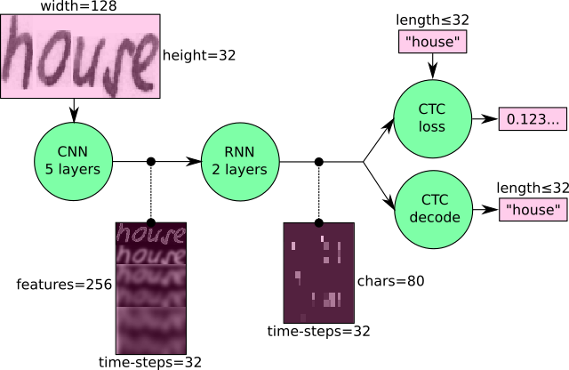

SYSTEM DESIGN
Fig. 2: Overview of the NN operations (green) and the data flow through the NN (pink).
We use a NN for our task. It consists of a convolutional neural network (CNN) layers, recurrent neural network (RNN) layers, and a final Connectionist Temporal Classification (CTC) layer.
In this project, we've taken 5 CNN (feature extraction) and a pair of RNN layers and a CTC layer (calculate the loss). first, we've to preprocess the pictures in order that we are able to reduce the noise.
We can also view the NN in an exceedingly more formal way as a function (see Eq. 1) which maps a picture (or matrix) M of size W×H to a personality sequence (c1, c2, …) with a length between 0 and L. As you'll see, the text is recognized on character-level, therefore words or texts not contained within the training data is recognized too (as long because the individual characters get correctly classified)
Eq. 1: The NN written as a mathematical function which maps an image M to a character sequence (c1, c2, …).

Slide 10
SYSTEM DESIGN
Operations
CNN: the input image is fed into the CNN layers. These layers are trained to extract relevant features from the image. Each layer consists of three operation. First, the convolution operation, which applies a filter kernel of size 5×5 in the first two layers and 3×3 in the last three layers to the input. Then, the non-linear RELU function is applied. Finally, a pooling layer summarizes image regions and outputs a downsized version of the input. While the image height is downsized by 2 in each layer, feature maps (channels) are added, so that the output feature map (or sequence) has a size of 32×256.
RNN: the feature sequence contains 256 features per time-step, the RNN propagates relevant information through this sequence. The popular Long Short-Term Memory (LSTM) implementation of RNNs is used, as it is able to propagate information through longer distances and provides more robust training-characteristics than vanilla RNN. The RNN output sequence is mapped to a matrix of size 32×80. The IAM dataset consists of 79 different characters, further one additional character is needed for the CTC operation (CTC blank label), therefore there are 80 entries for each of the 32 time-steps.
CTC: while training the NN, the CTC is given the RNN output matrix and the ground truth text and it computes the loss value. While inferring, the CTC is only given the matrix and it decodes it into the final text. Both the ground truth text and the recognized text can be at most 32 characters long.

Slide 11

SYSTEM DESIGN
Data
Input: it is a gray-value image of size 128×32. Usually, the images from the dataset do not have exactly this size, therefore we resize it (without distortion) until it either has a width of 128 or a height of 32. Then, we copy the image into a (white) target image of size 128×32. This process is shown in Fig. 3. Finally, we normalize the gray-values of the image which simplifies the task for the NN. Data augmentation can easily be integrated by copying the image to random positions instead of aligning it to the left or by randomly resizing the image.
Img 3: Left: an image from the dataset with an arbitrary size. It is scaled to fit the target image of size 128×32, the empty part of the target image is filled with white color.

Slide 12
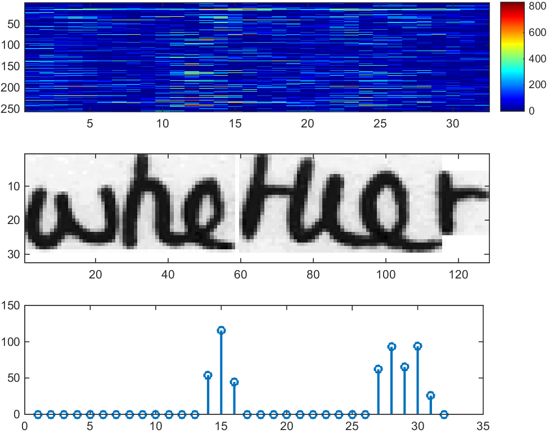
SYSTEM DESIGN
CNN output: Fig. 4 shows the output of the CNN layers which is a sequence of length 32. Each entry contains 256 features. Of course, these features are further processed by the RNN layers, however, some features already show a high correlation with certain high-level properties of the input image: there are features which have a high correlation with characters (e.g. “e”), or with duplicate characters (e.g. “tt”), or with character-properties such as loops (as contained in handwritten “l”s or “e”s).
Fig. 4: Top: 256 feature per time-step are computed by the CNN layers. Middle: input image. Bottom: plot of the 32nd feature, which has a high correlation with the occurrence of the character “e” in the image.

Slide 13
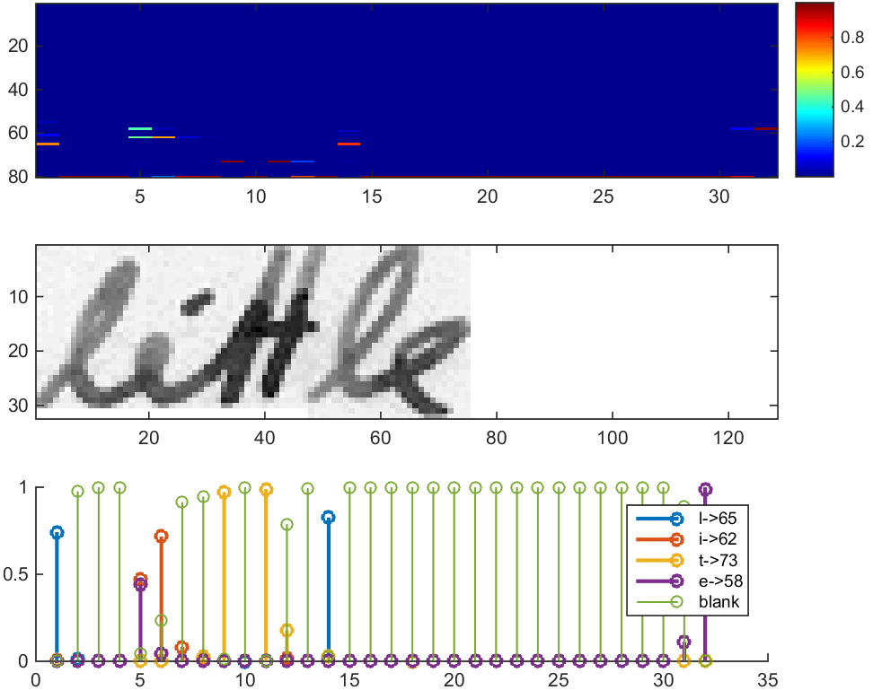
SYSTEM DESIGN
RNN output: Fig. 5 shows a visualization of the RNN output matrix for an image containing the text “little”. The matrix shown in the top-most graph contains the scores for the characters including the CTC blank label as its last (80th) entry. The other matrix-entries, from top to bottom, correspond to the following characters: “ !”#&’()*+,-./0123456789:;?ABCDEFGHIJKLMNOPQRSTUVWXYZabcdefghijklmnopqrstuvwxyz”. It can be seen that most of the time, the characters are predicted exactly at the position they appear in the image (e.g. compare the position of the “i” in the image and in the graph). Only the last character “e” is not aligned. But this is OK, as the CTC operation is segmentation-free and does not care about absolute positions. From the bottom-most graph showing the scores for the characters “l”, “i”, “t”, “e” and the CTC blank label, the text can easily be decoded: we just take the most probable character from each time-step, this forms the so called best path, then we throw away repeated characters and finally all blanks: “l---ii--t-t--l-…-e” → “l---i--t-t--l-…-e” → “little”.
Fig. 5: Top: output matrix of the RNN layers. Middle: input image. Bottom: Probabilities for the characters “l”, “i”, “t”, “e” and the CTC blank label.

Slide 14
DETAILED DESIGN
FUNCTIONAL MODULES
Implementation using TF
The implementation consists of 4 modules:
SamplePreprocessor.py: prepares the images from the IAM dataset for the NN
DataLoader.py: reads samples, puts them into batches and provides an iterator-interface to go through the data
Model.py: creates the model as described above, loads and saves models, manages the TF sessions and provides an interface for training and inference
main.py: puts all previously mentioned modules together
We only look at Model.py, as the other source files are concerned with basic file IO (DataLoader.py) and image processing (SamplePreprocessor.py).

Slide 15
IMPLEMENTATION
def train(model, loader):
epoch = 0 # number of training epochs since start
bestCharErrorRate = float('inf') # best valdiation character error rate
noImprovementSince = 0 # number of epochs no improvement of character error rate occured
earlyStopping = 5 # stop training after this number of epochs without improvement
while True:
epoch += 1
loader.trainSet()
while loader.hasNext():
iterInfo = loader.getIteratorInfo()
batch = loader.getNext()
loss = model.trainBatch(batch)
charErrorRate = validate(model, loader)
# if best validation accuracy so far, save model parameters
if charErrorRate < bestCharErrorRate:
#print('Character error rate improved, save model')
bestCharErrorRate = charErrorRate
noImprovementSince = 0
model.save()
open(FilePaths.fnAccuracy, 'w').write('Validation character error rate of saved model: %f%%' % (charErrorRate*100.0))
else:
#print('Character error rate not improved')
noImprovementSince += 1
# stop training if no more improvement in the last x epochs
if noImprovementSince >= earlyStopping:
#print('No more improvement since %d epochs. Training stopped.' % earlyStopping)
break
TRAINING CODE
import sys
import argparse
import cv2
import editdistance
from DataLoader import DataLoader, Batch
from Model import Model, DecoderType
from SamplePreprocessor import preprocess
import streamlit as st
import os
class FilePaths:
image_file = st.file_uploader("Upload An Image to predict the word",type=['png','jpeg','jpg'])
if image_file is not None:
file_details = {"FileName":image_file.name,"FileType":image_file.type}
with open(os.path.join("/content/drive/MyDrive/SimpleHTR/data",image_file.name),"wb") as f:
f.write(image_file.getbuffer())
path = os.path.join("/content/drive/MyDrive/SimpleHTR/data",image_file.name)
st.success("Saved File")
fnCharList = '../model/charList.txt'
fnAccuracy = '../model/accuracy.txt'
fnTrain = '../data/'
#fnInfer = 'path'
fnCorpus = '../data/corpus.txt'

Slide 16
IMPLEMENTATION
#print('Ground truth -> Recognized')
for i in range(len(recognized)):
numWordOK += 1 if batch.gtTexts[i] == recognized[i] else 0
numWordTotal += 1
dist = editdistance.eval(recognized[i], batch.gtTexts[i])
numCharErr += dist
numCharTotal += len(batch.gtTexts[i])
#print('[OK]' if dist==0 else '[ERR:%d]' % dist,'"' + batch.gtTexts[i] + '"', '->', '"' + recognized[i] + ‘“’)
# print validation result
charErrorRate = numCharErr / numCharTotal
wordAccuracy = numWordOK / numWordTotal
#print('Character error rate: %f%%. Word accuracy: %f%%.' % (charErrorRate*100.0, wordAccuracy*100.0))
return charErrorRate
def infer(model, fnImg):
"recognize text in image provided by file path"
img = preprocess(cv2.imread(fnImg, cv2.IMREAD_GRAYSCALE), Model.imgSize)
batch = Batch(None, [img])
(recognized, probability) = model.inferBatch(batch, True)
st.image(fnImg, caption='Image containing word')
st.title("Predicted word : ")
st.title(recognized[0])
st.title("Accuracy : ")
st.title(probability[0])
def validate(model, loader):
"validate NN"
#print('Validate NN')
loader.validationSet()
numCharErr = 0
numCharTotal = 0
numWordOK = 0
numWordTotal = 0
while loader.hasNext():
iterInfo = loader.getIteratorInfo()
#print('Batch:', iterInfo[0],'/', iterInfo[1])
batch = loader.getNext()
(recognized, _) = model.inferBatch(batch)

Slide 17
IMPLEMENTATION
def main():
"main function"
# optional command line args
parser = argparse.ArgumentParser()
parser.add_argument('--train', help='train the NN', action='store_true')
parser.add_argument('--validate', help='validate the NN', action='store_true')
parser.add_argument('--beamsearch', help='use beam search instead of best path decoding', action='store_true')
parser.add_argument('--wordbeamsearch', help='use word beam search instead of best path decoding', action='store_true')
parser.add_argument('--dump', help='dump output of NN to CSV file(s)', action='store_true')
args = parser.parse_args()
decoderType = DecoderType.BestPath
if args.beamsearch:
decoderType = DecoderType.BeamSearch
elif args.wordbeamsearch:
decoderType = DecoderType.WordBeamSearch
# train or validate on IAM dataset
if args.train or args.validate:
# load training data, create TF model
loader = DataLoader(FilePaths.fnTrain, Model.batchSize, Model.imgSize, Model.maxTextLen)
# save characters of model for inference mode
open(FilePaths.fnCharList, 'w').write(str().join(loader.charList))
# save words contained in dataset into file
open(FilePaths.fnCorpus, 'w').write(str(' ').join(loader.trainWords + loader.validationWords))
# execute training or validation
if args.train:
model = Model(loader.charList, decoderType)
train(model, loader)
elif args.validate:
model = Model(loader.charList, decoderType, mustRestore=True)
validate(model, loader)
# infer text on test image
else:
#print(open(FilePaths.fnAccuracy).read())
model = Model(open(FilePaths.fnCharList).read(), decoderType, mustRestore=True, dump=args.dump)
infer(model,FilePaths.path)
if st.button('Predict'):
main()

Slide 18
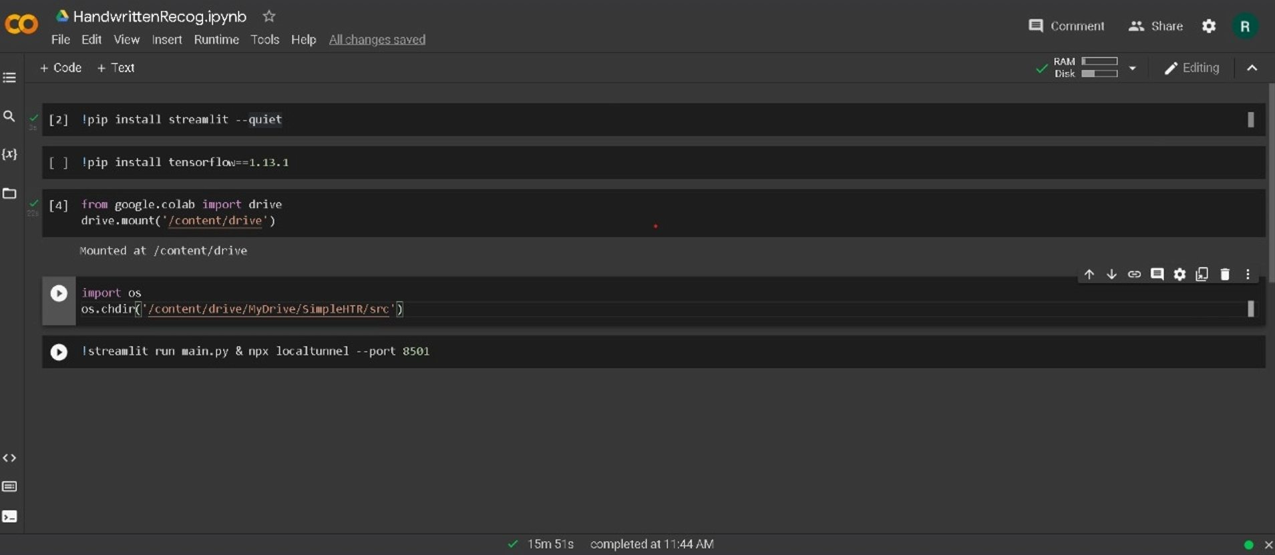
RESULTS

Slide 19
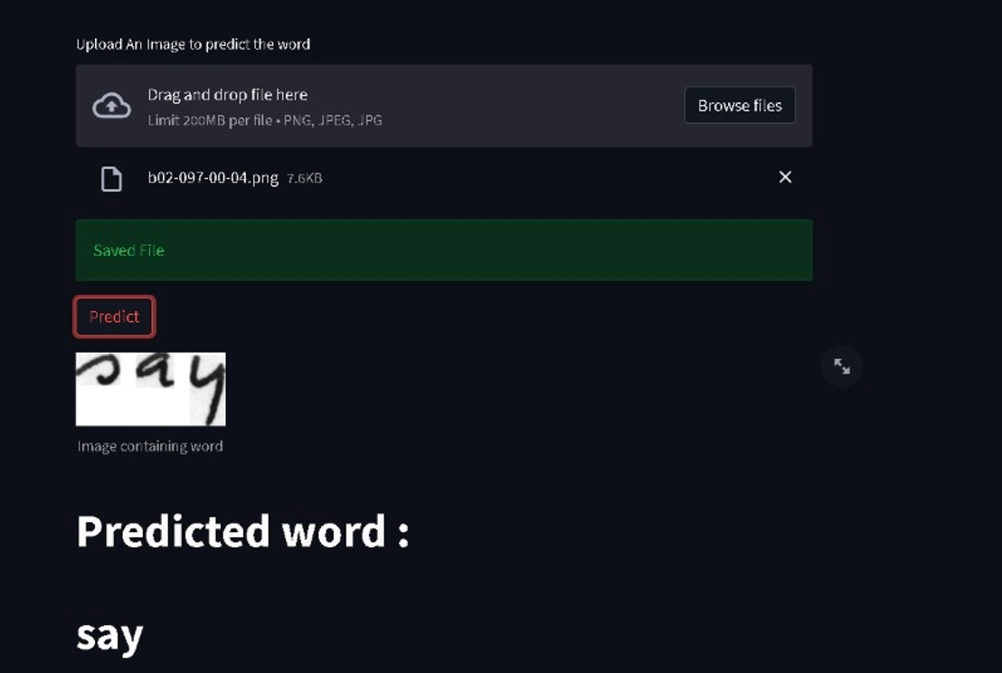
RESULTS
In this project we give the image as an input then it predicts the output by loading the model which is already previously created and saved.

Slide 20
CONCLUSIONS
CONCLUSION AND FUTURE SCOPE
In this project classification of characters takes place. The project is achieved through the conventional neural network. The accuracy we obtained in this is above 90.3%. This algorithm will provide both the efficiency and effective result for the recognition. The project gives best accuracy for the text which has less noise. The accuracy completely depending on the dataset if we increase the data, we can get more accuracy. If we try to avoid cursive writing then also its best results.
In future we are planning to extend this study to a larger extent where different embedding models can be considered on large variety of the datasets. The future is completely based on technology no one will use the paper and pen for writing. In that scenario they used write on touch pads so the inbuilt software which can automatically detects text which they writing and convert into digital text so that the searching and understanding very much simplified.

Slide 21
FUTURE ENHANCEMENTS
In case you want to feed complete text-lines as shown in Fig. 6 instead of word-images, you have to increase the input size of the NN.
Fig. 6: A complete text-line can be fed into the NN if its input size is increased (image taken from IAM).
If you want to improve the recognition accuracy, you can follow one of these hints:
Data augmentation: increase dataset-size by applying further (random) transformations to the input images
Remove cursive writing style in the input images (see DeslantImg)
Increase input size (if input of NN is large enough, complete text-lines can be used)
Add more CNN layers
Replace LSTM by 2D-LSTM
Decoder: use token passing or word beam search decoding (see CTCWordBeamSearch) to constrain the output to dictionary words
Text correction: if the recognized word is not contained in a dictionary, search for the most similar one

Slide 22
REFERENCES
[1] Fischer, A., Frinken, V., Bunke, H.: Hidden Markov models for off-line cursive handwriting recognition, in C.R. Rao (ed.): Handbook of Statistics 31, 421 – 442, Elsevier, 2013
[2] Frinken, V., Bunke, H.: Continuous handwritten script recognition, in Doermann, D., Tombre, K. (eds.): Handbook of Document Image Processing and Recognition, Springer Verlag, 2014
[3] S. Günter and H. Bunke. A new combination scheme for HMM-based classifiers and its application to handwriting recognition. In Proc. 16th Int. Conf. on Pattern Recognition, volume 2, pages 332–337. IEEE, 2002.
[4] U.-V. Marti and H. Bunke. Text line segmentation and word recognition in a system for general writer
[5] M. Liwicki and H. Bunke, “Iam-ondb - an on-line English sentence database acquired from the handwritten text on a whiteboard,” in ICDAR, 2005
[6] A. Graves and J. Schmidhuber, “Offline handwriting recognition with multidimensional recurrent neural networks,” in Advances in neural information processing systems, 2009, pp. 545–552.
[7] Nafiz Arica, and Fatos T. Yarman-Vural, ―Optical Character Recognition for Cursive Handwriting,ǁ IEEE Transactions on Pattern Analysis and Machine Intelligence, vol.24, no.6, pp. 801-113, June 2002.

Slide 23
REFERENCES
[8] Anita Pal and Davashankar Singh,”Handwritten English Character Recognition Using Neural Network”, International Journal of Computer Science and Communication, pp: 141- 144, 2011.
[9] Sandhya Arora, “Combining Multiple Feature Extraction Techniques for Handwritten Devnagari Character Recognition”, IEEE Region 10 Colloquium and the Third ICIIS, Kharagpur, INDIA, December 2008
[10] Om Prakash Sharma, M. K. Ghose, Krishna Bikram Shah, “An Improved Zone Based Hybrid Feature Extraction Model for Handwritten Alphabets Recognition Using Euler Number”, International Journal of Soft Computing and Engineering (ISSN: 2231 - 2307), Vol. 2, Issue 2, pp. 504- 508, May 2012.
[11] N. Venkata Rao and Dr. A.S.C.S.Sastry - ―Optical CharacterRecognition Technique Algorithmsǁ-2016 Journal of Theoretical and Applied Information Technology.
[12] J.Pradeep, E.Srinivasan and S.Himavathi –―Diagonal based feature extraction for handwritten alphabets recognition system using neural networkǁ - International Journal of Computer Science & Information Technology (IJCSIT), Vol 3, No 1, Feb 2011.
[13] Manoj Sonkusare and Narendra Sahu “A SURVEY ON HANDWRITTEN CHARACTER RECOGNITION (HCR) TECHNIQUES FOR ENGLISH ALPHABETS” Advances in Vision Computing: An International Journal (AVC) Vol.3, No.1, March 2016 .

Slide 24
Question and Answer

Slide 25
THANK YOU

